Slide 1

MSc in Business Analytics
ITOM, Nanyang Business School
August 2020
ttteoh@ntu.edu.sg
97905202
Dr Teoh Teik Toe

Slide 2

Singapore, a Cosmopolitan Global Melting Pot
Singapore – Heart of Asia
One of the fastest growing economic regions in the world that helps tap into Asia’s growth
Global Business Hub
World’s most competitive nation¹, with the best investment potential ²
Dynamic, Multi-racial & Multi-cultural
Unique confluence of East and West, Asia’s most culturally diverse country and most liveable cities ³
Source:
2019 WEF Global Competitiveness Report
According to the US-based research institute Business Environment Risk Intelligence (BERI), 2014
Quality of Living Worldwide City Rankings, Mercer Survey 2019

Slide 3






A Rich History in Education
1955
Nanyang University founded for the Chinese diaspora living in Singapore
1991
Nanyang Technological Institute (NTI) merges with National Institute of Education to form NTU
2014-2019
Ranked 1st in the world among universities below age 50 by QS

Slide 4






Consistently ranked one of the
best in Asia
13th
QS World University
Ranking 2020
1st
QS Top 50 under 50
2014 - 2020
2nd
Times Higher Education Young
University Ranking 2020

Slide 5
NTU: A Top-Performing University
Global Diversity
42,000 students
from over
83 countries
3,800 teaching and research staff
from over 70 nations
Over 210,000 alumni spread over 120 countries, with 36 overseas alumni associations

Slide 6




Yunnan Garden Campus
200 Hectares
1.34 Mil m²
Built-up Space
665,000 m²
Academic Space
NTU’s lush 200-hectare campus is named one of the world’s top 15 most beautiful campuses by the Travel + Leisure magazine.

Slide 7

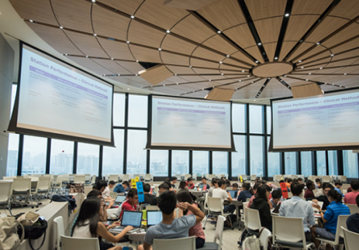
One-North & Novena Campuses
One-North Campus
Educational and
Alumni House Facilities
Novena Campus
Brand New 20-Storey
Clinical Sciences Building (CSB)

Slide 8
Nanyang Business School
College of Engineering
College of Science
College of Humanities, Arts & Social Sciences
Interdiscipli-nary Graduate School
Lee Kong Chian School of Medicine
Cradle@NTU
S Rajaratnam School of International Studies
Earth Observatory of Singapore
S’pore Centre on Environment-al Life Sciences Engineering
National Institute of Education
Comprehensive
Multi-Disciplinary

Slide 9

Graduate Studies
900+
participants in 2020 across:
Nanyang MBA
Nanyang Professional MBA
Nanyang Executive MBA
Nanyang Fellows MBA
MSc Accountancy
MSc Business Analytics
MSc Financial Engineering
MSc Marketing Science
PhD
Nanyang Executive Education (Chinese and English)
Chinese programmes: EMBA (Chinese), MSc Finance (English and Chinese), Nanyang-Peking MSc Finance (English & Chinese), Executive Programmes (Chinese)

Slide 10


Slide 11

Young, Research Intensive
12
Asian Business Case Centre (ABCC)
Centre for Accounting and Auditing Research (CAAR)
Centre for Applied Financial Education (CAFE)
Centre for Business Sustainability (CBS)
Centre for Excellence International Trading (CEIT)
Centre for Leadership and Cultural Intelligence (CLCI)
Centre for RMB Internationalisation Studies (CRIS)
Culture Science Institute (CSI)
Information Management Research Centre (IMARC)
Insurance Risk and Finance Research Centre (IRFRC)
Nanyang Centre for Emerging Markets (CEM)
NTU-SBF Centre for African Studies (CAS)
research centres bringing together leading academics and industry experts to develop cutting-edge research that is impactful and relevant to latest industry needs.

Slide 12

World-class Faculty
200+ faculty members from 26 countries
Graduates from top global universities with strong academic qualifications
Extensive international experience coupled with rich and diverse industry experience
First-rate teaching skills
Professor Vijay Sethi
The World’s Best Business Professor
Awarded by Economist Intelligence Unit (EIU) in 2013
Nanyang MBA professor for almost two decades

Slide 13
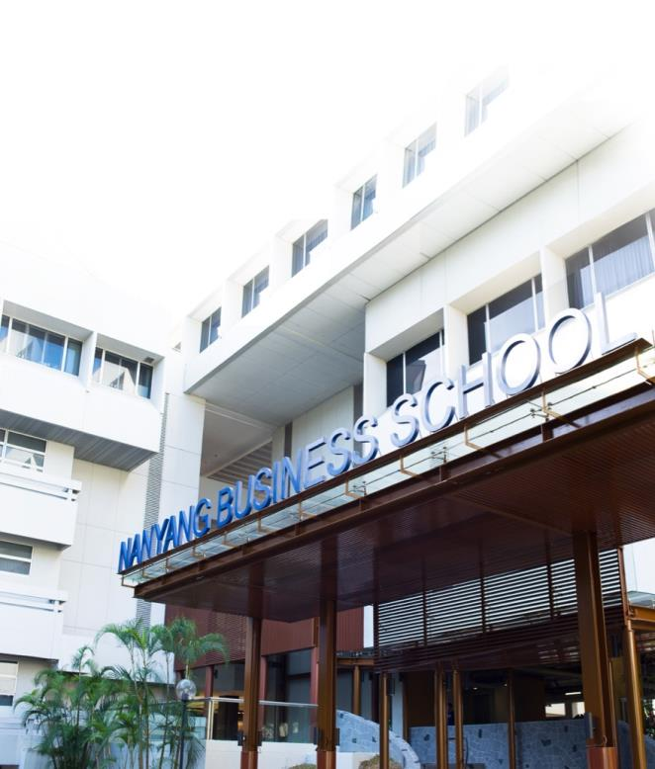
Nanyang Business School
In 1995, NTU’s School of Accountancy and Business was renamed Nanyang Business School – an institution that is consistency counted among the world’s top-tier business school
6,800+ students
Research-oriented interdisciplinary studies
Industry-relevant education
Well-recognised globally by companies which employ our students

Slide 14
Business Analytics in light of the digital era
Forbes Research on Using Business Analytics impact on Digitisation:
53% of companies are using business analytics today
55% of companies in North America
53% of companies in the Middle East, and Africa (EMEA)
44% of companies in Asia-Pacific

Slide 15

Growing Demand for Data Roles in Singapore - JobTech
Data Analytics roles (>1,800 jobs posted since Jan 2019):
Business Analytics roles (>4,000 jobs posted since Jan 2019)
Data Analytics related roles increased by more than 40% from 2017 to 2018
Business Analytics related roles increased by 36%
Online job postings for Data Analytics Q1 2019 increase by 15% over Q1 2018 indicating a sustained demand for data analytics roles
During the same period, online job postings for Business Analytics Q1 2019 increase by 10%
w w w. j o b t e c h .c o
t a l e n t e d . j o b t e c h .c o

Slide 16
Why Study Business Analytics?
Transform businesses, and increase productivity using Analytics/Data Science/AI
Add value to organisation
Vast career and specialisation options
Do what you love
Always in demand in good and bad times
Great compensation
https://www.studyinternational.com/news/business-analytics-will-shape-digital-future/

Slide 17
Top Skills of Business Analytics in Singapore
Technical Skills | Domain Knowledge
Business Analytics | Regulatory Compliance
Project Management | Business Finance
Data Analytics | Retail Banking
Sales | User Acceptance Testing
Marketing | SOPs/Best Practices
SQL | Web Services
Microsoft Office (Excel) | Financial Services
Risk Management | Investment
Strategic Business Planning | Telecommunications
User Experience Design | SCRUM/Agile
User Research | E-Payment
Trend Analysis | Information Technology
Pre-Sales | Statistics
Quality Audit/Management | SDLC
Python | Consulting

Slide 18
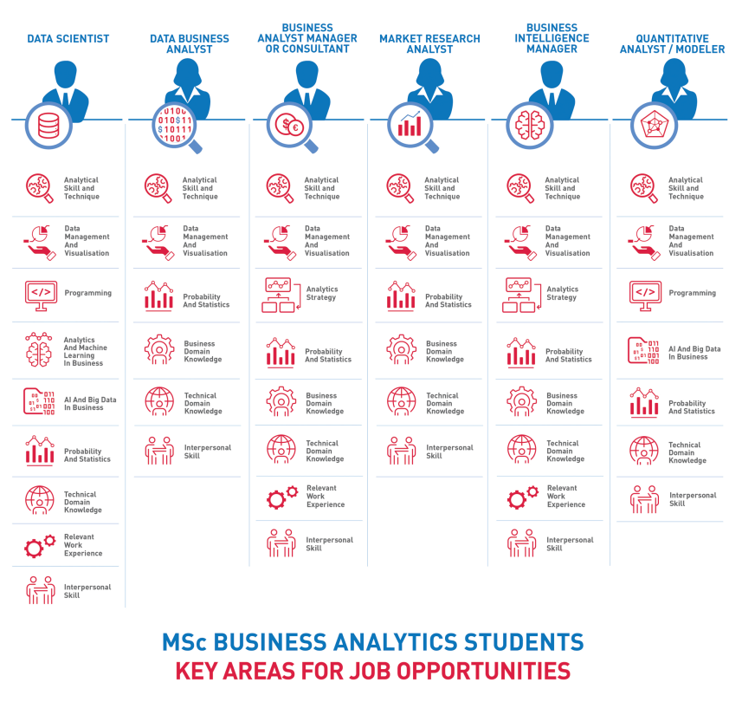

Slide 19

Is Business Analytics for you?
“YES!”, if you are:
Organised and Detail-oriented
Good Analytical Skill
A Numbers Person
Have Strong People Skills
Strategic, "Big Picture" Person

Slide 20










Why NTU MSBA
Our differentiating curriculum
Industry-relevant and practice-oriented curriculum;
Curriculum is designed in partnership with industry partners
Real-world case studies provided by industry partners
Advanced modules in Machine Learning and AI in Business
Internship opportunities with key industry partners
Welcomes candidates from non-technical and non-quantitative backgrounds
Contemporary and State-of-the-Art Tools

Slide 21
Two Tracks
Full-Time
Part-Time
1.5 years to 2 years
1 year
Lessons on weekday evenings & Sat
Same class as FT students for all modules
Lessons on weekday evenings & Sat

Slide 22
Core and Elective Modules
Core Modules | No. of Academic Units
Data Management and Visualisation | 3
Introduction to Statistical Analysis | 3
Analytics and Machine Learning in Business | 3
AI and Big Data in Business | 3
Analytics Strategy | 3
Project I | 3
Project II | 3
Electives | No. of Academic Units
Programming Essentials* | 3
Lean Operations & Analytics | 3
AI with Advanced Predictive Techniques in Finance | 1.5
AI in Enterprise | 1.5
Marketing and Customer Analytics | 1.5
Supply Chain Analytics | 3
​Design Thinking & Technology Management | 1.5
​Cybersecurity and Blockchain Technology | 1.5
​Fundamentals of Machine Learning | 1.5
​Data Analytics for Credit and Related Risk | 1.5
​Deep Learning and Contemporary AI in Business | 1.5
*The module "Programming Essentials" will be applicable to full-time participants to take as a compulsory elective.​​​
Notes:
Amend core and electives

Slide 23
MSc Business Analytics Schedule (Full-Time)
Bridging Analytics and Business
Optional: Industrial Attachment for Projects
Optional Internship/ Exchange
12
months
3 weeks before Trimester 1
1st Trimester
2nd Trimester
3rd Trimester
JUL
JUL - NOV
NOV - FEB
FEB - MAY
Programming Essentials
Programming Essentials
AI and Big Data in Business
Introduction to Statistical Analysis
Analytics Strategy
Data Management and Visualization
Analytics and Machine Learning in Business
Project I
Elective I
Elective II
Elective III
Elective IV
Project II
Class Schedule Weekdays: 3 – 4 Evenings Saturdays: Half to Full day

Slide 24
MSc Business Analytics Schedule (Part-Time)
Bridging Analytics and Business
Optional Exchange
1.5 to 2 years
1st Trimester
2nd Trimester
3rd Trimester
4th Trimester
5th Trimester
6th Trimester
JUL - NOV
NOV - FEB
FEB - MAY
JUL - NOV
NOV - FEB
NOV - FEB
AI and Big Data in Business
Analytics Strategy
Project I
Elective IV
Project II
Elective V
Introduction to Statistical Analysis
Data Management and Visualisation
Analytics and Machine Learning in Business
Elective I
Elective II
Elective III
Class Schedule Weekdays: 1 – 2 Evenings Saturdays: Half to Full day

Slide 25
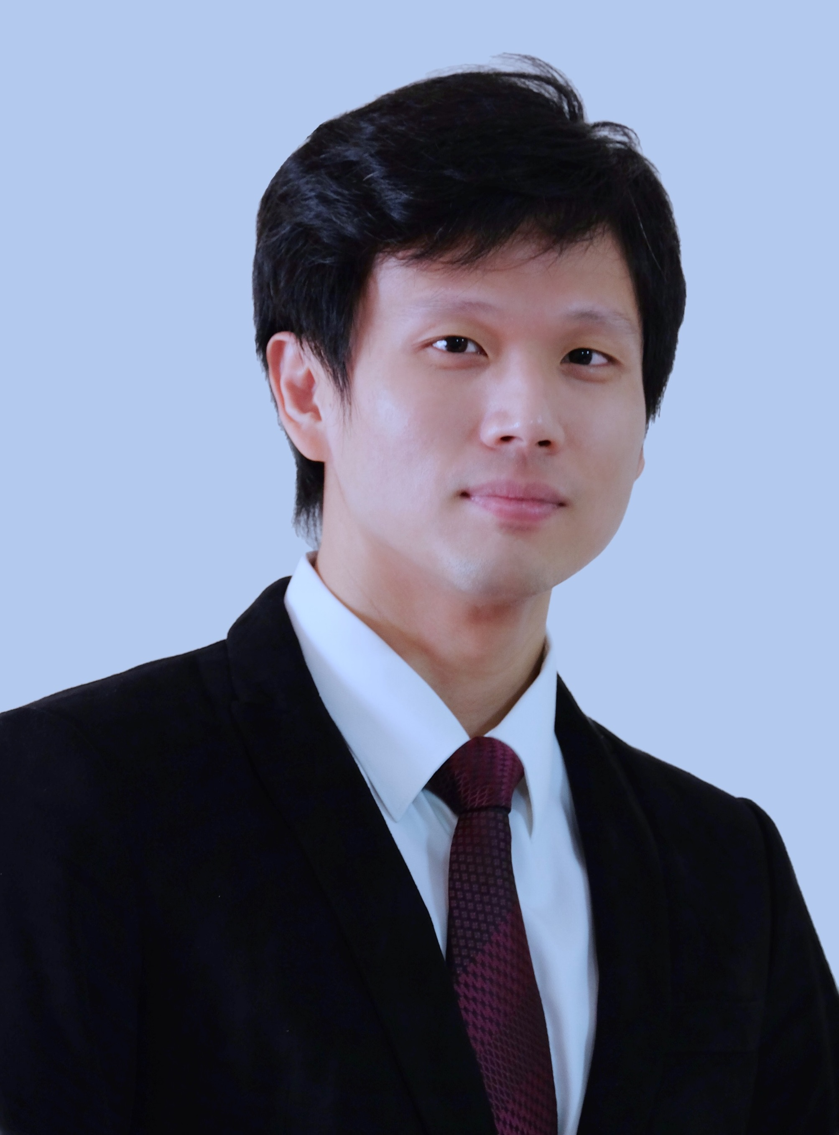
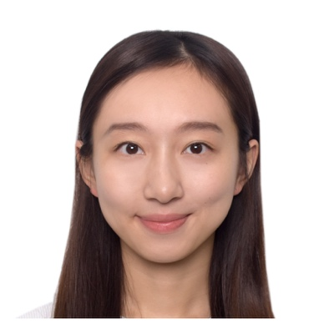
Hear from our students
“With extensive industry links, the NTU MSBA is designed around real-world scenarios. On top of equipping with practical skills, it imparts insightful approaches in staying relevant for the future.”
William Lim Singapore National University of Singapore, Bioengineering Site Lead, Inventory Management Solutions
“I chose the NTU MSBA program because it’s rigorous curriculum suits both my academic and career goals. With access to the Nanyang Business school’s renowned academic resources, I can surely develop my knowledge of the latest analytical tools, the right statistical techniques, along with my interpersonal skills and strategic thinking. ”
Zhao Yifan, Eva China The Chinese University of Hong Kong, Business Administration

Slide 26
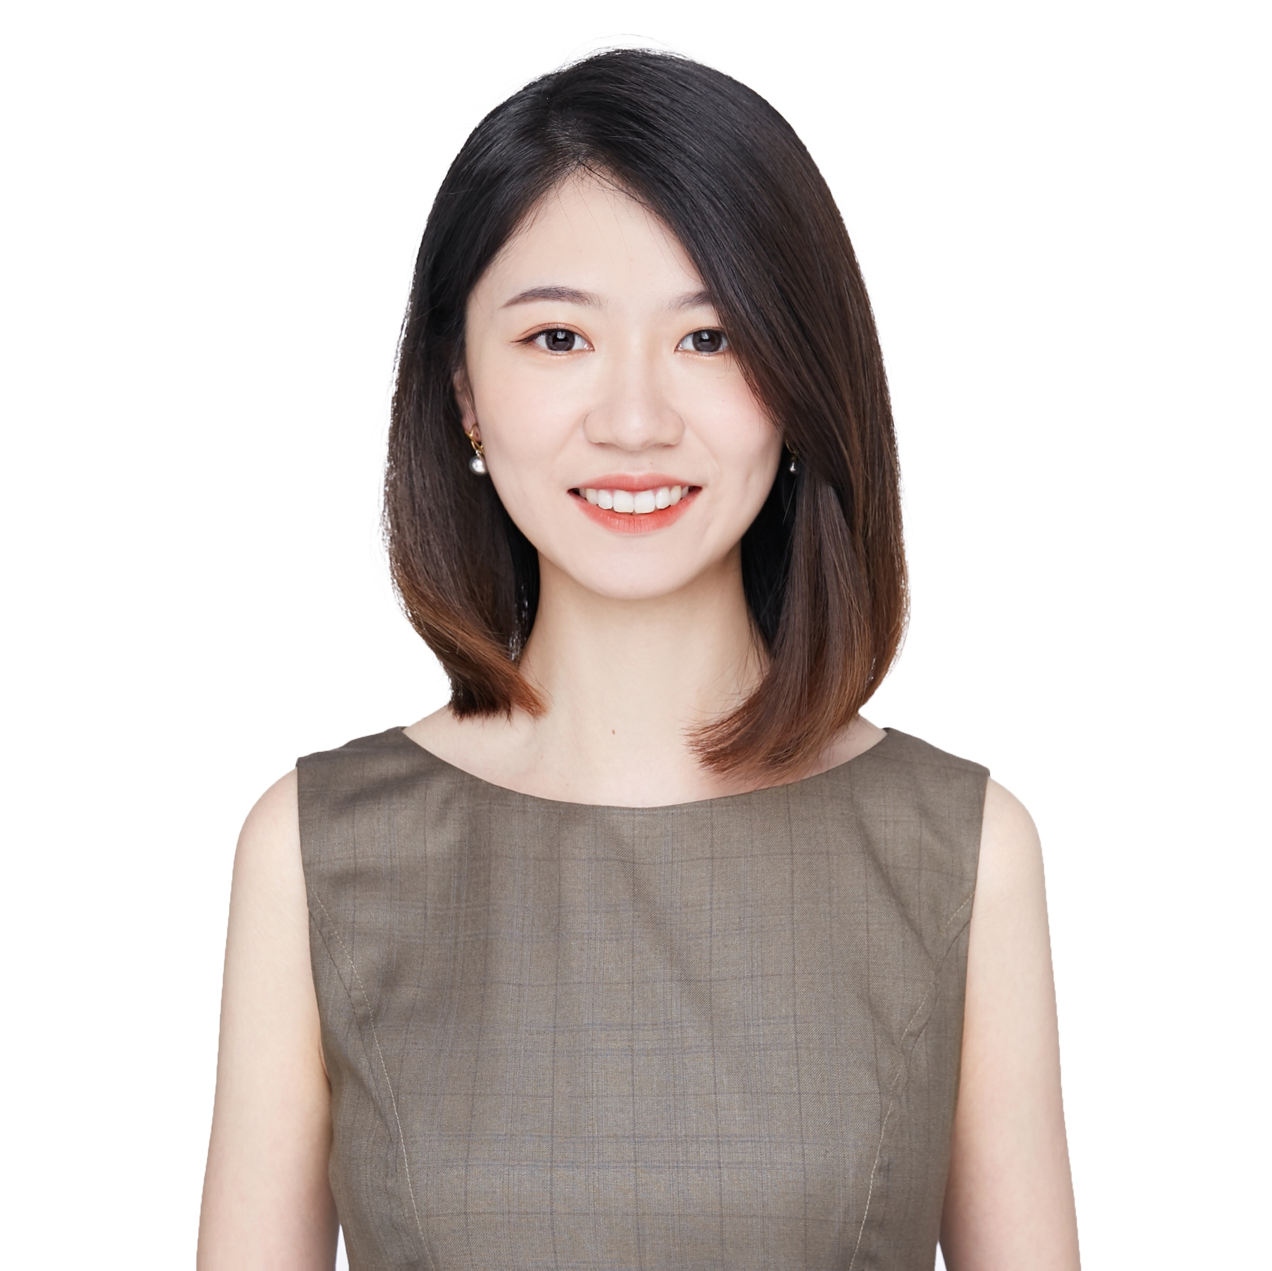
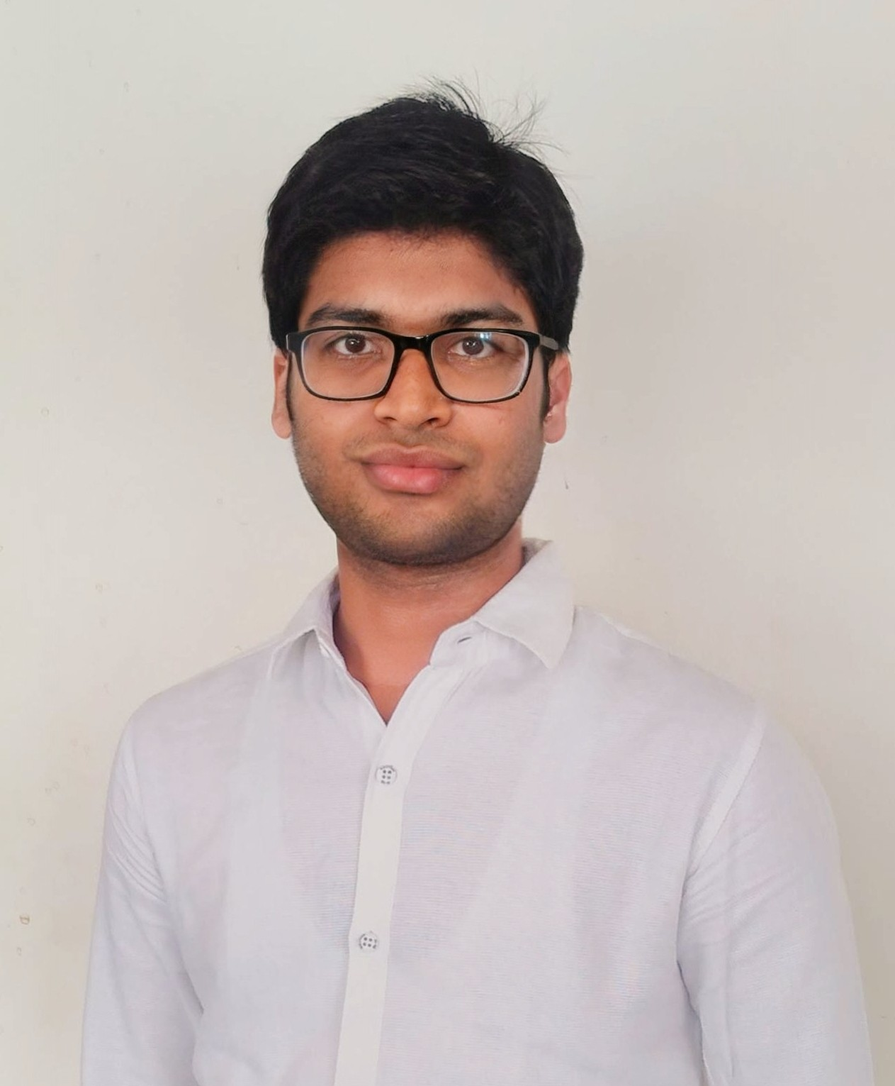
Hear from our students
“The fast-pacing, thrilling and engaged life with 360° support from
the MSBA office and the Nanyang Business School makes me firmly believe that I made the right choice and will be on the way to achieve my goal.”
Ge Xinyi, Olivia China Beijing International Studies University, Russian Language and Literature Sales Manager, Online Travel & Innovation, Amadeus
“The curriculum of the MSBA Program at NBS is carefully designed to include the latest technologies and skills required to pursue career in Business/Data Analytics which motivated me to choose the MSBA from NBS.”
Goyal Vivek India VIT University, Computer Science and Engineering Associate Consultant, Microsoft

Slide 27
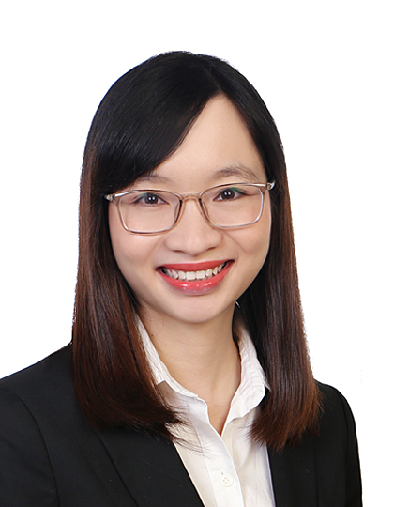
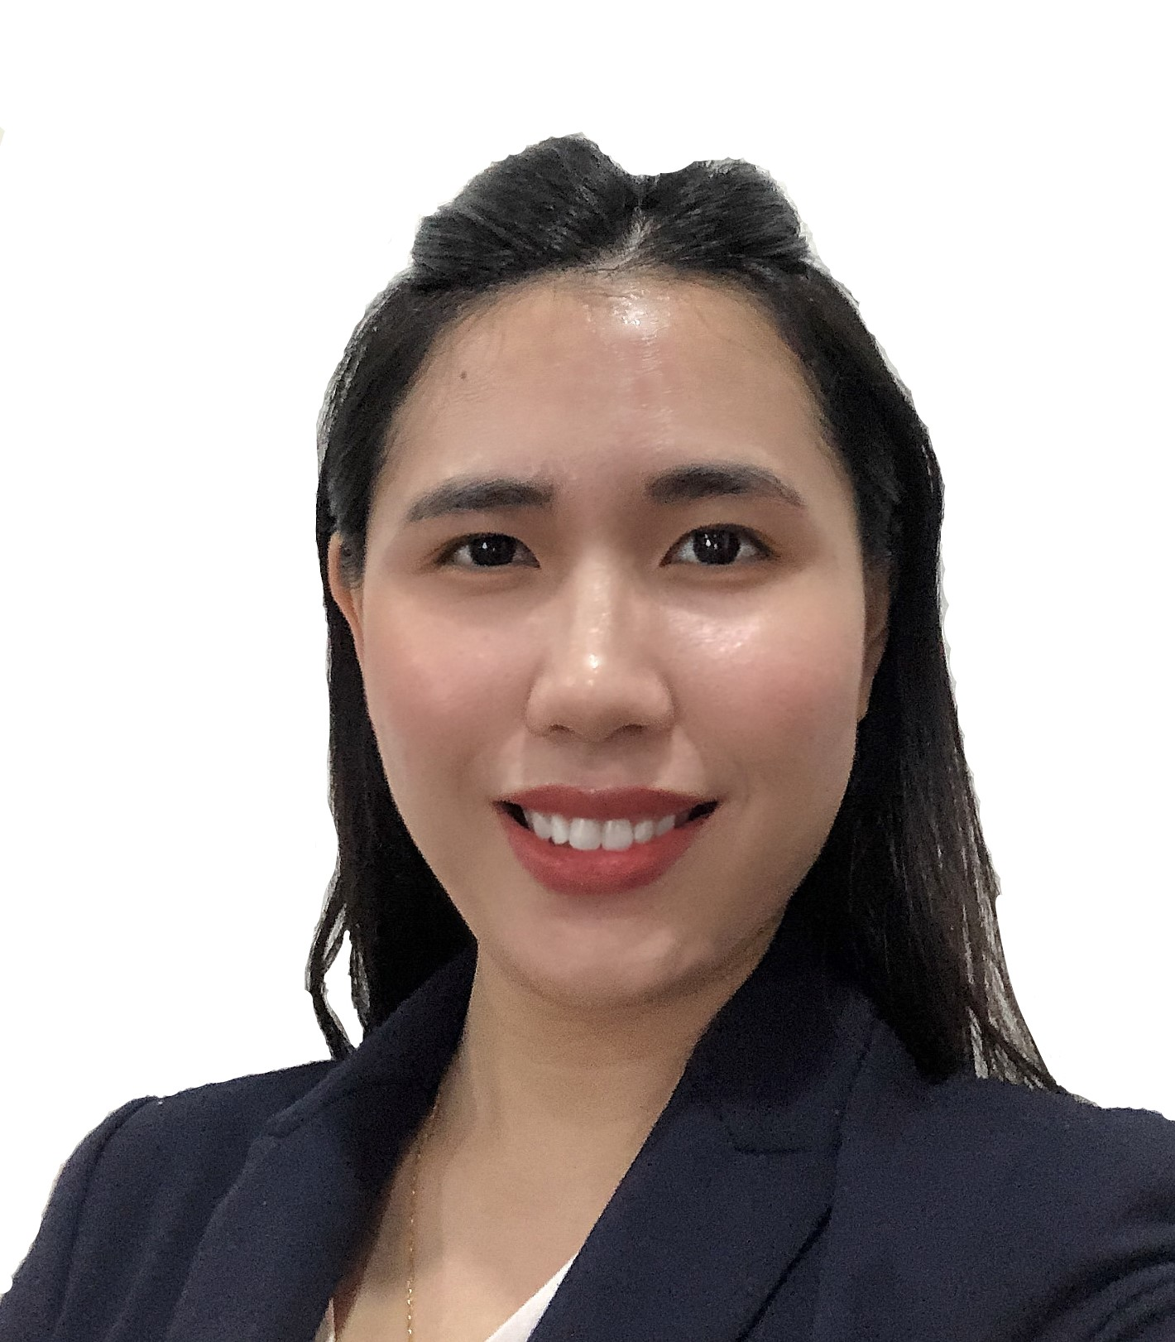
Hear from our students
“I used to think that we will not know what will happen in the future, until I see people predict it with the mathematical analysis of historical data. It is never too early or late to embark on future skills like Business Analytics to keep ourselves competitive in the changing world.”
Lily Tran Vietnam Hanoi Foreign Trade University, Economics Lead Business Analyst & Project Manager, AvePoint Singapore
“Having earned an undergraduate degree in commerce and with a few years of working experience in various industries, I see the great potential to change the way of business by combining technology to digitize and effectively managing enormous amounts of data. I chose to further my studies in MSBA with NTU as I believe it can best equip me with the necessary expertise to handle real-world data analytics problems.”
Gan Pou Ing Malaysia University of Queensland, Accounting and Finance Customer Service, Federal Express Pte Ltd

Slide 28

Gain access to countless Career Opportunities & Extensive Alumni Network

Slide 29
How GSCDO Partners our Graduate Students in their Career Development Journey
Graduate Studies Career Development Office (GSCDO) partners and guides all graduate students through their career development journey to achieve their goals within a realistic timeline
Realise & Develop your Potential
Understand your Best Industry/ Functional Fit
Connect you with Opportunities
Network with Diverse Industry Professionals
A dedicated employer engagement specialist from NBS who understands your industry and your recruitment needs
A career counsellor that provides 1-on-1 career coaching support
Comprehensive suite of career workshops, e.g. professional etiquette, networking, resume writing and interview preparation to ensure participants meet employers’ high demands

Slide 30
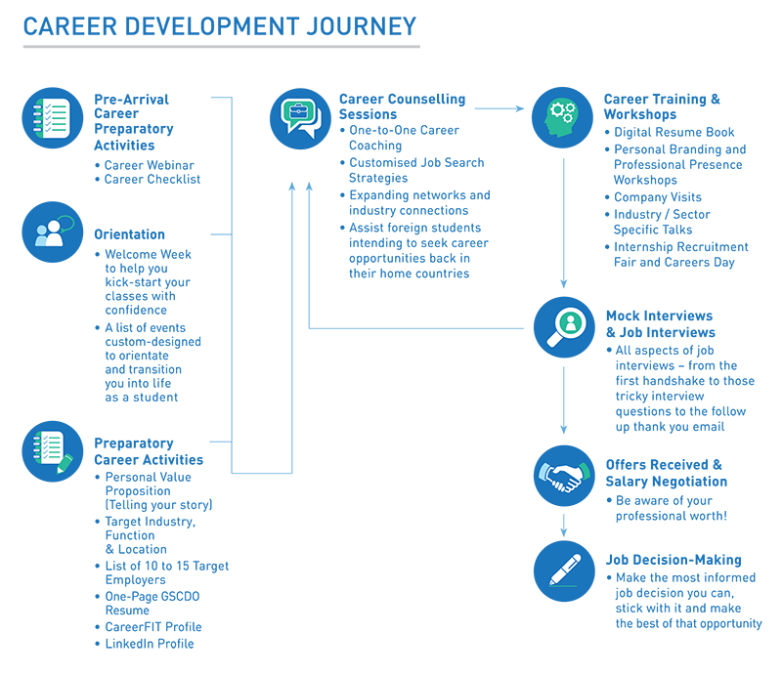
Our Career Development Journey

Slide 31
Powerful Alumni Network
Over 224,000 NTU alumni members in 157 countries
>50,000 Business School alumni members in 89 countries over 6 continents
Alumni Associations in:
Cambodia
China
Europe Gulf Cooperation Council
India
Indonesia
Malaysia
Myanmar
Myanmar
Philippines
Singapore
Taiwan
Thailand
United Kingdom
United States of America
Vietnam
Notes:
http://www.nbs.ntu.edu.sg/Alumni/Pages/AlumniAssociations(Overseas).aspx
For country specific presentations, refer to above link if you wish to indicate no. of alumni in that country

Slide 32










Some of our MSBA Industry Partners

Slide 33
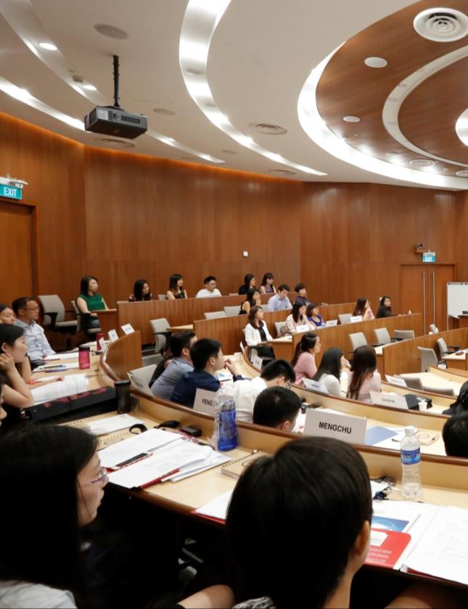
Class Profile

Slide 34
Class Profile
2020/21
22.6
3.1
Average Age
Avg. Years of Work Exp.
6
80
Citizenships
Class Size

Slide 35

Tuition &
Admissions

Slide 36
Admissions Requirements & Tuition Fee
Nanyang MSc Business Analytics
Tuition Fees
(inclusive of 7% GST)
SGD 52,000
(Inclusive of enrolment fee below)
Application
Deadlines
Round 1 – 30 Nov 2020
Round 2 – 31 Jan 2021
Round 3 – 31 Mar 2021
Bachelor’s Degree in any field. Candidates from non-technical background are welcome to apply
Competitive GMAT or GRE score
TOEFL or IELTS score (if applicable)
Fresh graduates are welcome to apply
Admission
Requirements
Application Fee
SGD 100 (non-refundable)
Enrolment Fee
SGD 10,000 (non-refundable, payable upon acceptance of offer)

Slide 37
Scholarships & Grants
NBS Merit Scholarship
Scholarship amount will be determined by the Scholarship Committee
Full Coverage of Tuition and other compulsory school fees
Sponsorship support for approved courses and certifications
Support for overseas experience
SG-Digital (SG:D) Scholarship
(applicable to Singapore citizens only)
NTU Alumni Grant
10% of tuition fee
Singapore Citizen/ SPR Grant
10% of tuition fee
Note: You will be awarded either the NTU Alumni Grant or Singapore Citizen/ SPR Grant even if you are eligible for both

Slide 38
Application Timeline & Process
4-6 weeks
4-6 weeks
End of application period
Start Application
Submit Application
Interview Decision*
Admission Decision*
Scholarship Decision*
Create online profile
Upload info, supporting documents and complete essays
Application fee of SGD100
Referee report template will be auto-sent upon submission
Evaluation begins upon receipt of all supporting documents
Notification of interview shortlist via email
Attend F2F or Skype interview as scheduled
Offer announced via email
Confirm acceptance with SGD10,000 enrolment fee within stipulated deadline
Announced via email
Application for July 2021 intake is now open!
https://www.applynbs.com/apply/
*Only shortlisted/successful candidates will be notified

Slide 39

Upcoming Events
Contact the Admissions
Team
SINGAPORE
www.msba.ntu.edu.com
msba@ntu.edu.sg
+65 6904 2048
WeChat ID: zeejay84
Nanyang Business School Postgraduate Fair
Sat, 19 August 2017, 12 noon to 5pm
Raffles City Convention Centre
Registration is required at www.thenanyangmba.com
INTERNATIONAL
Coffee Chat in Osaka & Tokyo, Japan
19 to 27 July 2017
Coffee Chat in Jakarta & Bandung, Indonesia
24 to 28 August 2017
Coffee Chat in Bangkok, Thailand
31 August to 3 September 2017
Registration is required for all events, please register via www.thenanyangmba.com

Slide 40
Career in Singapore

Slide 41
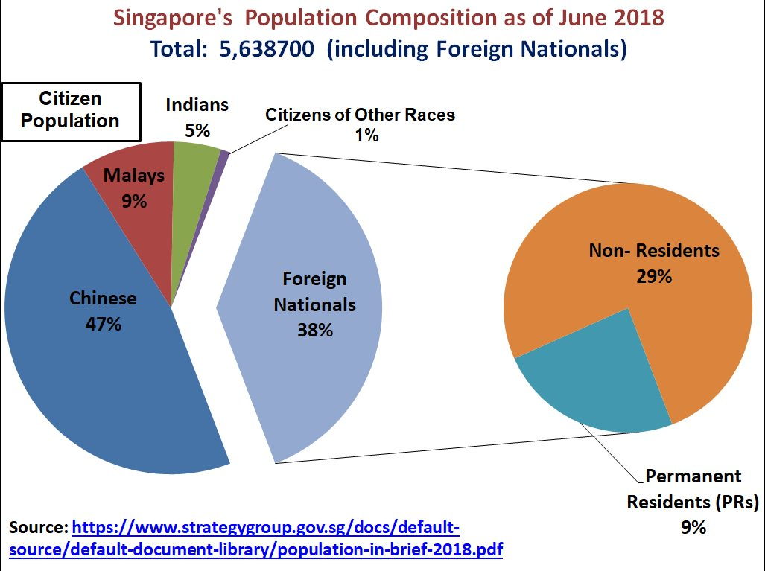

Slide 42
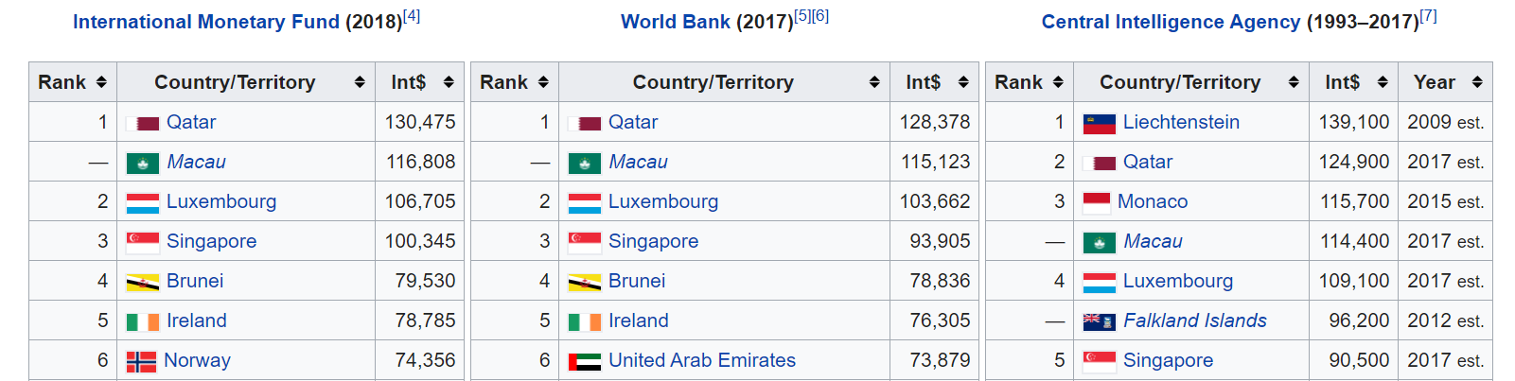
Singapore GDP
https://blog.seedly.sg/salary-guide-singapore/

Slide 43
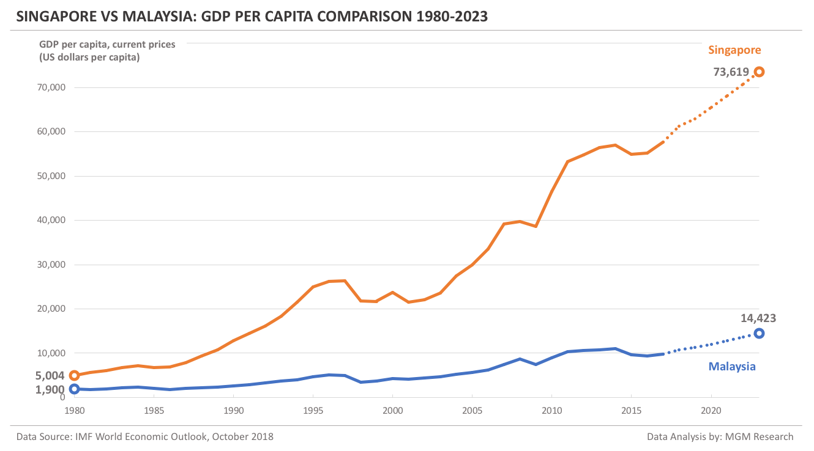
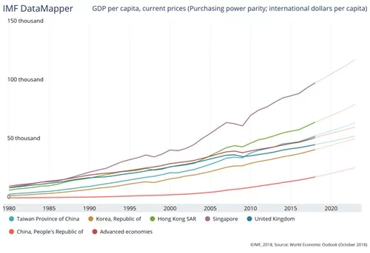
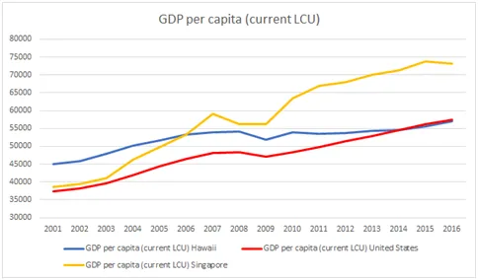

Slide 44
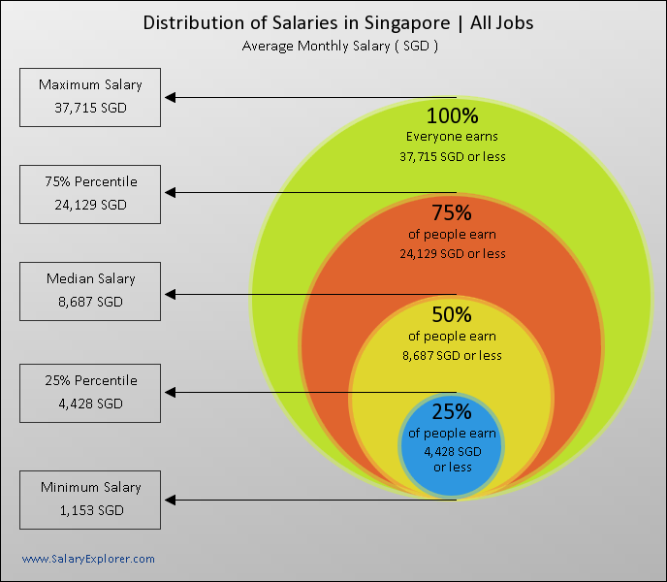

Slide 45
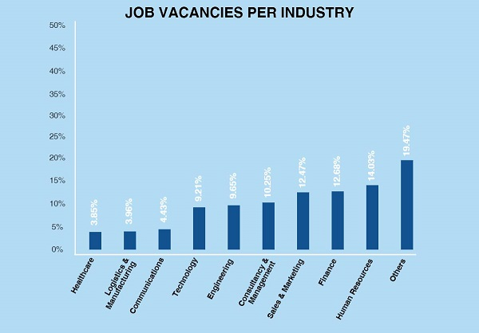

Slide 46
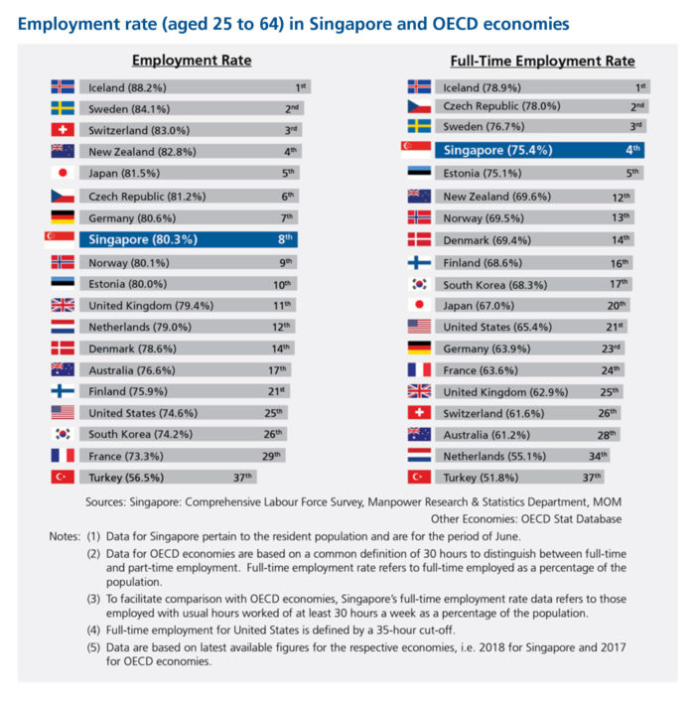
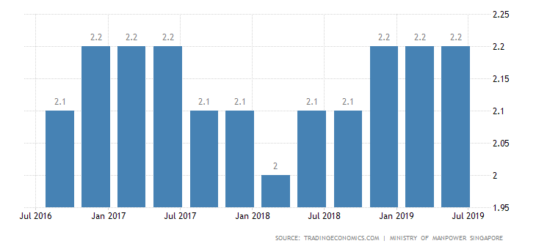
Employment Rate

Slide 47
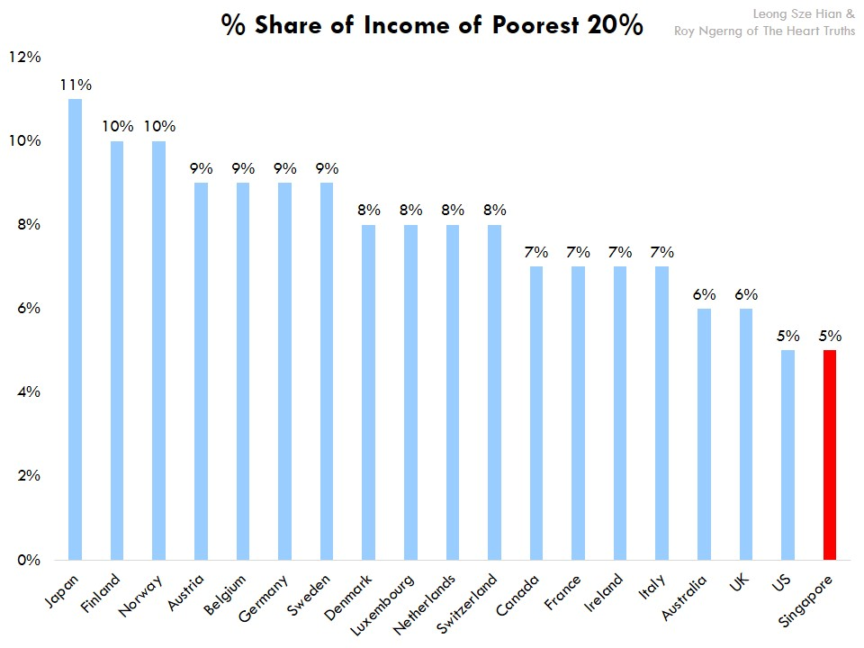
Low Income Tax

Slide 48
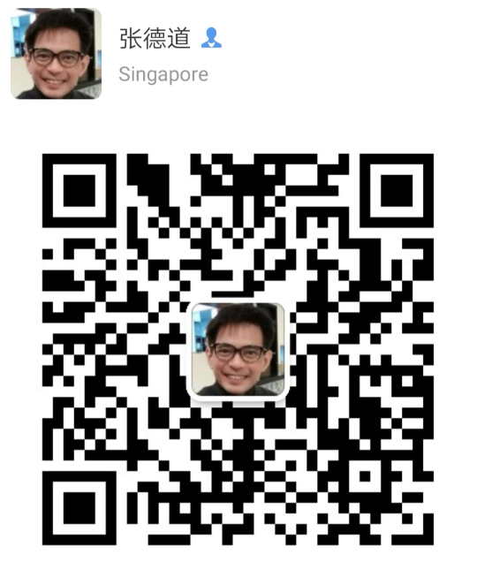
Upcoming Events
Dr Teoh Teik Toe
Academic Director MSc Business Analytics
Nanyang Business School
ttteoh@ntu.edu.sg
+65 9790 5202
WeChat ID: Teoh Teik Toe
Contact the Admissions
Team
SINGAPORE
Nanyang Business School Postgraduate Fair
Sat, 19 August 2017, 12 noon to 5pm
Raffles City Convention Centre
Registration is required at www.thenanyangmba.com
INTERNATIONAL
Coffee Chat in Osaka & Tokyo, Japan
19 to 27 July 2017
Coffee Chat in Jakarta & Bandung, Indonesia
24 to 28 August 2017
Coffee Chat in Bangkok, Thailand
31 August to 3 September 2017
Registration is required for all events, please register via www.thenanyangmba.com

Slide 49

Thank you.

